Slide 1

FlowGuard
A Multi-Agent Digital Twin System
for Real-World Crowd Management
FOUNDATIONS OF ARTIFICIAL INTELLIGENCE
Presented by
MANISHA M 2116240701304
MATHU METHAA K 2116240701306

Slide 2
Problem Statement & Abstract
Problem Statement
Abstract
Large gatherings at stadiums, religious sites and public venues face recurring crowd-safety risks during entry, exit and emergencies. Today's options are manual stewarding with no simulated support, or single-venue commercial twins that need heavy sensor infrastructure.
FlowGuard builds a multi-agent digital twin for any location picked on a map. It pulls real gates, footpaths and roads from OpenStreetMap, estimates crowd capacity from polygon area and satellite imagery, and lets classical AI agents decide how to route and respond.
BDI Agents
Utility Coordinator
Dijkstra & A*
CSP Solver
Crowd, Route and Safety agents perceive the twin and form goals.
Scores candidate plans on evacuation time, density and safety.
Real shortest and safest paths on the OpenStreetMap graph.
Assigns crowd groups to exits under capacity and distance limits.
No ML or DL: every decision traces back to a rule, a score or a search algorithm

Slide 3
Literature Survey
Author & Year | Methodology | Drawback | Improvement in FlowGuard
Li et al. (2021) | Survey of sensor, feature and decision-level data fusion for crowd monitoring. | Descriptive only; no routing or decision-making. | A working decision pipeline (agents + Coordinator), not just a taxonomy.
Noor (2023) | Hidden Markov Model classifies CCTV footage into normal or abnormal flow (Hajj/Umrah). | Needs dense CCTV; detects problems but decides no response. | No cameras needed; map data plus agent-driven rerouting.
Li, S. (2022) | IoT-based stadium management system architecture. | No AI decision layer; one fixed venue. | Works for any venue and adds the missing AI decision layer.
Mu (2023) | 1,500+ WiFi access points used as passive sensors on a campus. | Privacy-sensitive device tracking; observation only. | Uses public map data and adds real intervention.
Zhong et al. (2024) | Four-layer digital twin for airport crowd control. | Airport-specific; not shown to generalize. | Same twin-to-decision layering, but location-independent.
Common thread (1/2): the studies either monitor crowds without deciding what to do, or lean on hardware that is tied to one venue.

Slide 4
Literature Survey
Author & Year | Methodology | Drawback | Improvement in FlowGuard
Yasufuku & Takahashi (2024) | Agent-based simulation platform predicting congestion 10-20 minutes ahead. | Their own analysis: linear prediction misses crowd dynamics. | No numeric prediction; the Coordinator scores explicit plans.
Meng et al. (2022) | A* with path-density and obstacle cost for multi-storey ship evacuation. | Ship-specific; one algorithm, no multi-agent coordination. | Density-aware routing inside a full multi-agent system with CSP.
Golubić (2023) | Review of Dijkstra, A* and linear programming for evacuation planning. | Theory only; no implementation or real data. | Implemented and tested on real stadium graphs with live simulation.
Dinh Thi Hong Huyen et al. (2023) | Dijkstra with route-capacity limits and blocked-route re-planning. | Capacity is assumed; no estimation or agent coordination. | Estimates capacity (OSM + image analysis); adds CSP and agents.
Chen & Zhang (2025) | 4K cameras, infrared, UWB and MobileNetV3 edge computing for a smart gym. | Heavy hardware; cannot scale to a new venue. | Zero hardware; any venue is available from OpenStreetMap.
FlowGuard closes all three gaps: real OpenStreetMap data (no hardware), capacity estimation, and BDI multi-agent coordination, for any location.

Slide 5
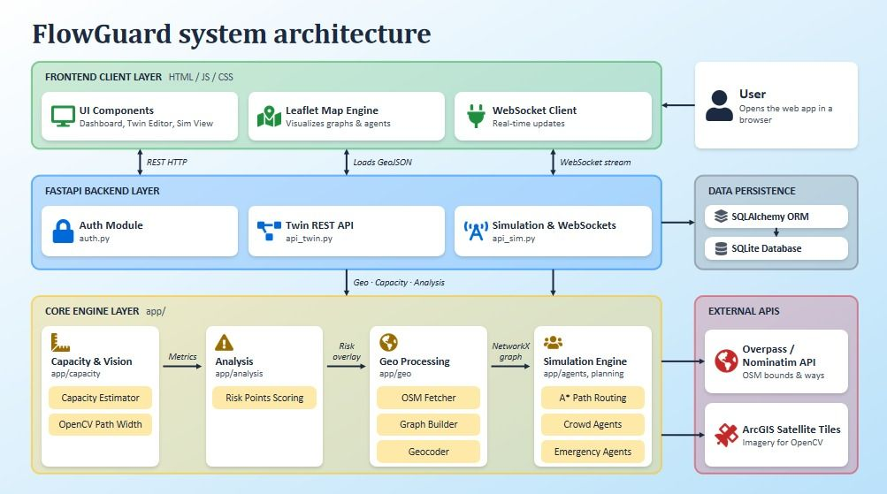
SYSTEM ARCHITECTURE

Slide 6
Implementation
User
Frontend
Backend
Twin Builder
Agents
Live Map
Selects a location on the map
➜
Leaflet map, HTML / CSS / JS
➜
FastAPI, JWT, WebSocket
➜
OSM graph + OpenCV capacity
➜
BDI + Coordinator + CSP
➜
Crowd, routes, risk layers
Stack & Setup
Results
Python: FastAPI, SQLite, NetworkX
OpenStreetMap Overpass + Nominatim geocoding
OpenCV HSV segmentation for capacity
Dijkstra, A*, priority queue, CSP backtracking
Scenarios: blocked gate, zone incident, inflow surge, combined crisis
3
506 – 1,085
real Tamil Nadu venues tested
graph nodes per twin
~35,600
12
average estimated capacity
risk points flagged
Agent-driven rerouting cut average evacuation time and peak zone density versus an unmanaged baseline.

Slide 7






Modules
MODULE 1
MODULE 2
MODULE 3
Authentication & Twin Management
Location-Based Twin Generation
Capacity Estimation
JWT login with bcrypt hashing; users save, view and delete their own twins.
Turns an address or map click into a NetworkX graph of real gates, paths and roads.
Polygon area plus OpenCV satellite analysis gives a comfortable / dense / danger range.
MODULE 4
MODULE 5
MODULE 6
Multi-Agent Crowd Management
Risk Analysis & Emergency Response
Simulation & Visualization
BDI agents perceive the twin; a utility Coordinator picks the best action plan.
Flags bottlenecks, narrow paths and stairs; routes responders and ranks hospitals.
Tick-based live simulation on a Leaflet map with a readable agent-reasoning trace.

Slide 8
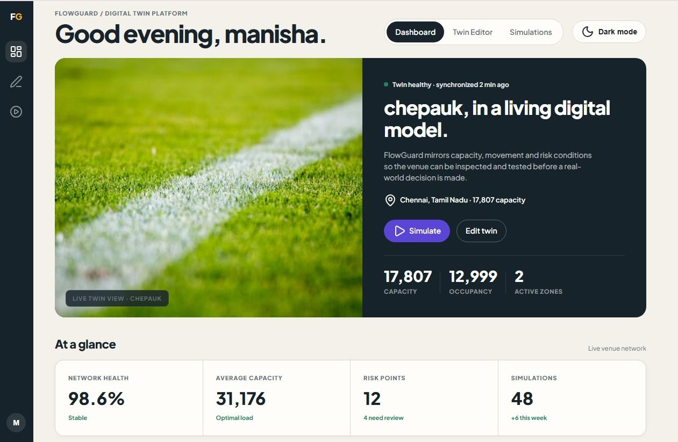
RESULTS

Slide 9

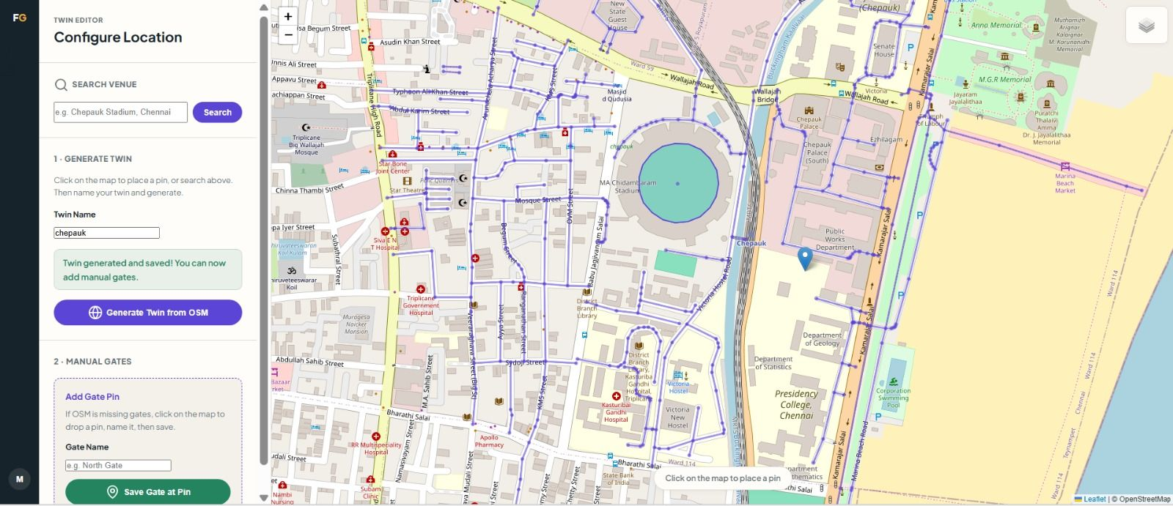
RESULTS

Slide 10
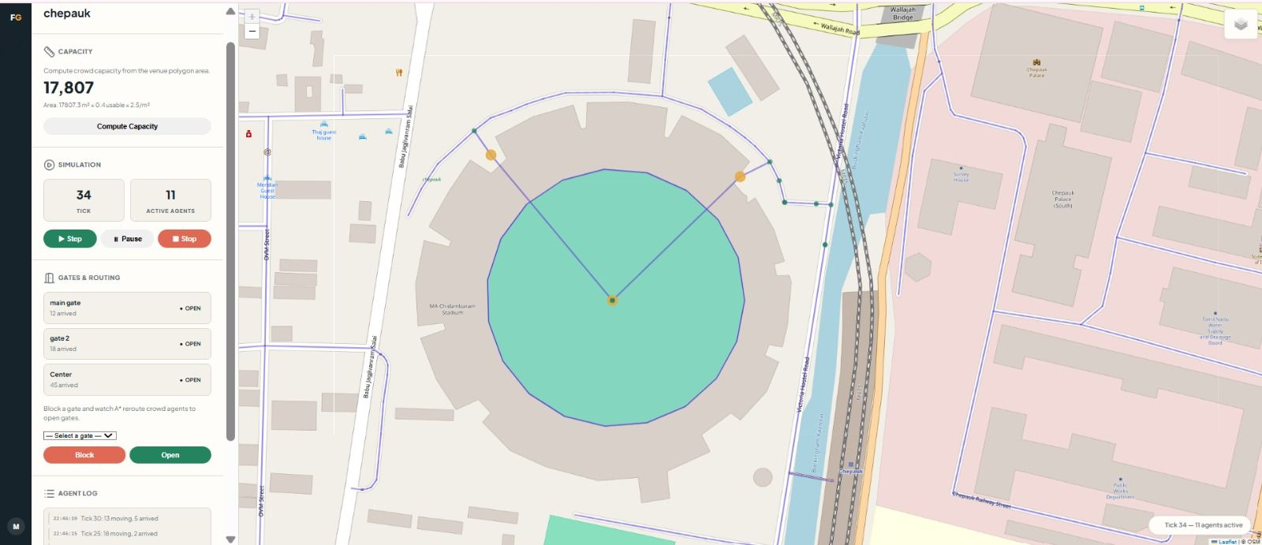
RESULTS

Slide 11
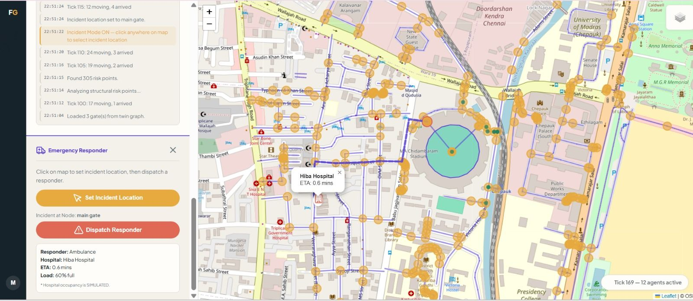
RESULTS

Slide 12


Conclusion & Future Enhancements
Conclusion
Future Enhancements
One pipeline adapts to any real venue; it worked on three Tamil Nadu stadiums without venue-specific tuning.
Combines OpenStreetMap data, image-based capacity, BDI agents, a utility Coordinator, Dijkstra / A* and CSP.
Fully explainable: no ML or DL, every decision is a visible rule, score or search.
Agent rerouting measurably lowered evacuation time and peak density against an unmanaged baseline.
Transparent, non-ML demand forecasting from holiday, festival and weather data.
Visitor-facing SMS / app notifications.
Live road-traffic integration for responder routing.
Validation against publicly reported real-world congestion incidents.
Negotiation-based coordination between agents with competing goals (e.g. Route vs Parking Agent).

Slide 13
References
1. Li, X. et al. (2021) 'Data Fusion for Intelligent Crowd Monitoring and Management Systems: A Survey', IEEE Access, Vol. 9.
2. Noor, T.H. (2023) 'Behavior Analysis-Based IoT Services for Crowd Management', The Computer Journal, 66(9), pp. 2208-2220.
3. Li, S. (2022) 'Development of Intelligent Sports Stadium System Based on Internet of Things Technology', Proc. CTMCD 2022.
4. Mu, M. (2023) 'Network as a Sensor for Smart Crowd Analysis and Service Improvement', IEEE Network, 37(2), pp. 144-152.
5. Zhong, J. et al. (2024) 'Intelligent Airport Crowd Management Technology Based on Digital Twin', J. System Simulation, 36(1), pp. 27-38.
6. Yasufuku, K. and Takahashi, A. (2024) 'Development of a Real-Time Crowd Flow Prediction and Visualization Platform for Crowd Management', J. Disaster Research, 19(2), pp. 248-255.
7. Meng, D., Hu, Z. and Zhang, H. (2022) 'Simulation of Multi-layer Ship Evacuation System Based on Improved A* Algorithm', J. System Simulation, 34(6), pp. 1375-1382.
8. Golubić, I. (2023) 'Mathematical Evacuation Planning: Graph Theory and Optimization Approaches', DKU Journal, Veleučilište Velika Gorica.
9. Dinh Thi Hong Huyen et al. (2023) 'Solving Optimization Problems in Emergency Evacuation', J. Science and Technology, Univ. of Danang, 6.2.
10. Chen, J. and Zhang, D. (2025) 'Design of IoT-Based Crowd Flow Monitoring System for Smart Sports Venues', Advances in Transdisciplinary Engineering, 70.
11. Dijkstra, E.W. (1959) 'A note on two problems in connexion with graphs', Numerische Mathematik, 1, pp. 269-271.
12. Rao, A.S. and Georgeff, M.P. (1995) 'BDI Agents: From Theory to Practice', Proc. ICMAS-95.
13. Russell, S. and Norvig, P. (2021) Artificial Intelligence: A Modern Approach, 4th edn, Pearson.
14. OpenStreetMap contributors (2024) OpenStreetMap, openstreetmap.org (accessed 2026).
15. Hagberg, A., Swart, P. and Chult, D.S. (2008) 'Exploring network structure, dynamics, and function using NetworkX', SciPy 2008, pp. 11-15.

